Slide 1
ODI WORLD CUP 2023 Data analysis
ODI World Cup 2023 Data Analysis -
This presentation provides an in-depth analysis of the ODI World Cup 2023, covering key performance metrics of teams and players. The analysis includes:
Top Performers: Identifying the highest run-scorer among batsmen and the leading wicket-taker among bowlers.
Win Percentage: Calculating and comparing the win percentage of each team to evaluate overall performance.
Team & Player Insights: Additional queries exploring strike rates, economy rates, average runs per match, and team consistency.
Comparative Analysis: Visualizations highlighting trends, key matches, and statistical correlations between batting, bowling, and team success.
This data-driven approach provides valuable insights into the tournament's standout performances and competitive trends.

Slide 2
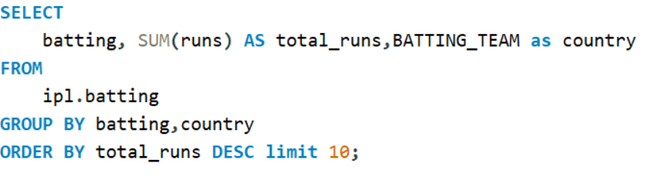
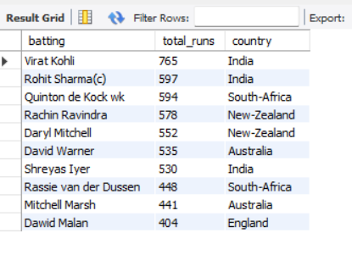
Top 10 highest runs of batsman

Slide 3
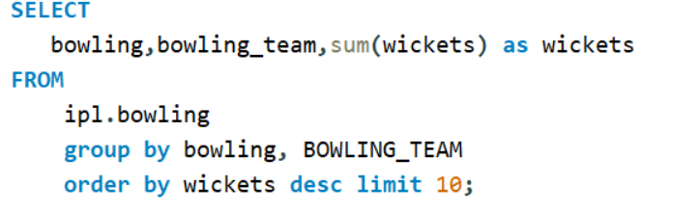
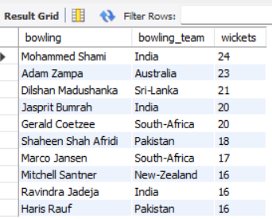
Top 10 highest wicket taker bowler

Slide 4
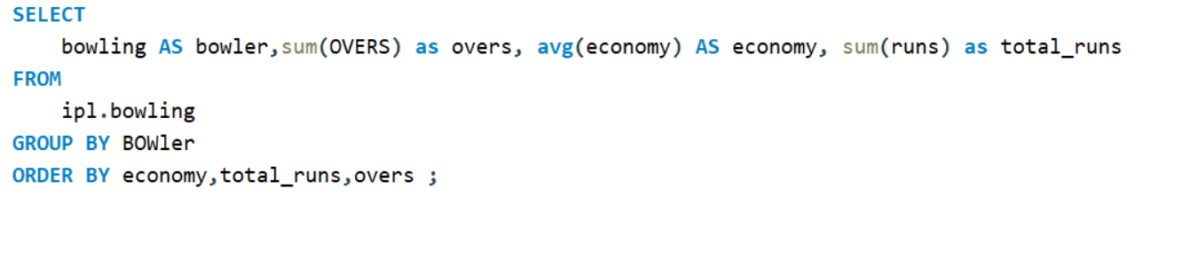
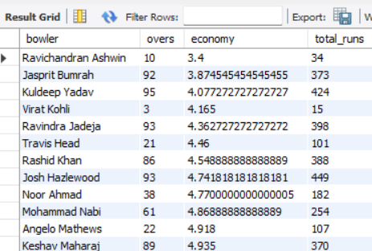
Best economy of bowlers and given runs

Slide 5
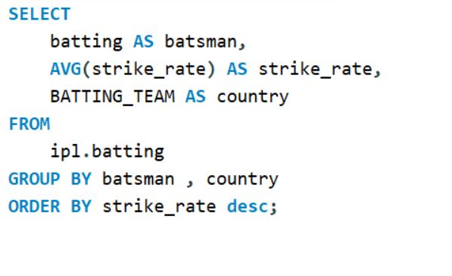
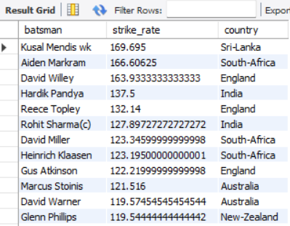
Batsman with best strike rate

Slide 6
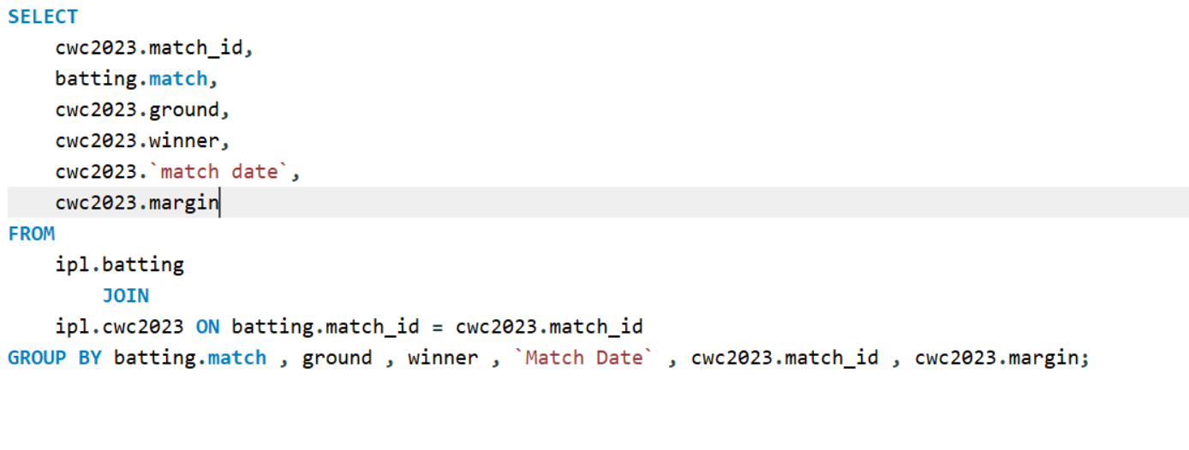
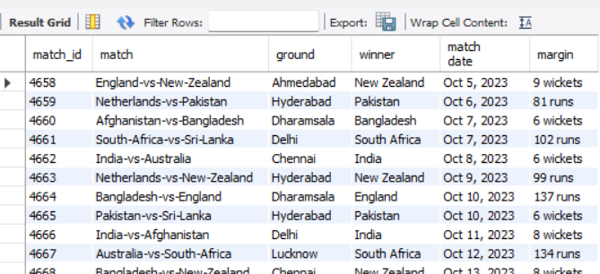
Matches list and their result margin

Slide 7
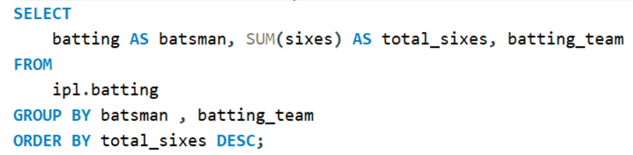
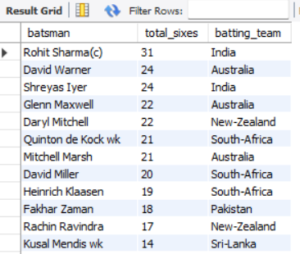
Most sixes hit by a player

Slide 8
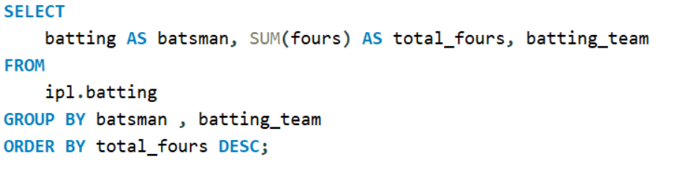
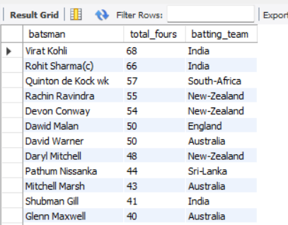
Most fours hit by a player

Slide 9
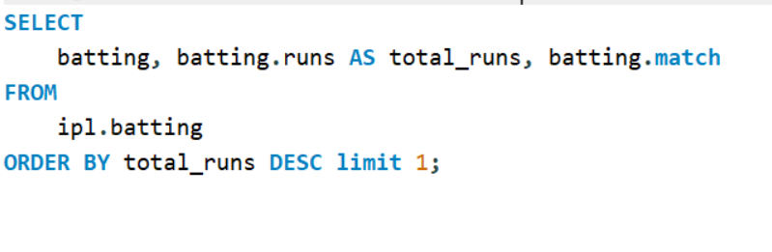
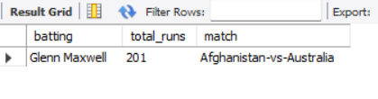
Highest individual score in a match

Slide 10
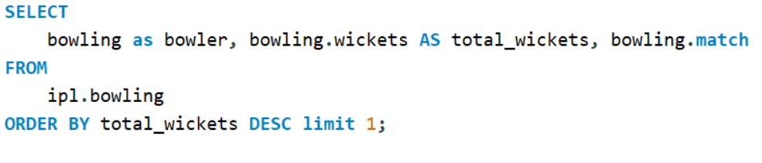
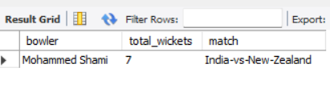
Highest wickets in a match

Slide 11
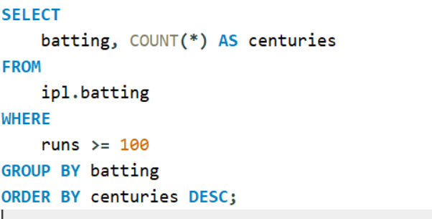
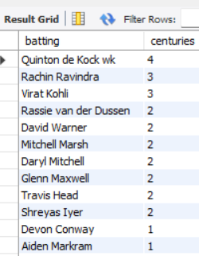
Players with most centuries

Slide 12
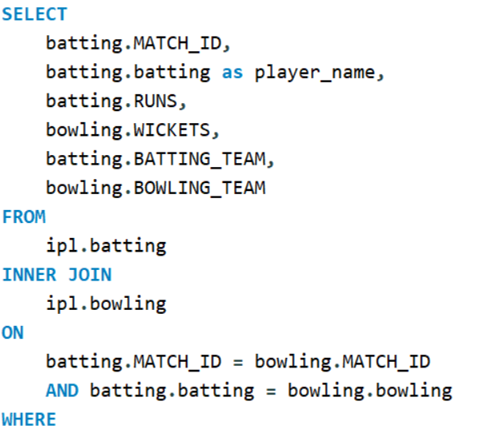
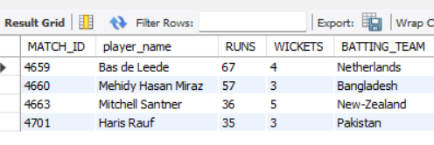
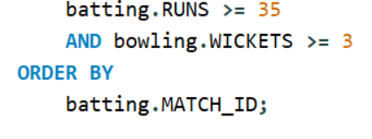
Best all-rounder performances (minimum 35 runs and 3 wickets in a match):

Slide 13
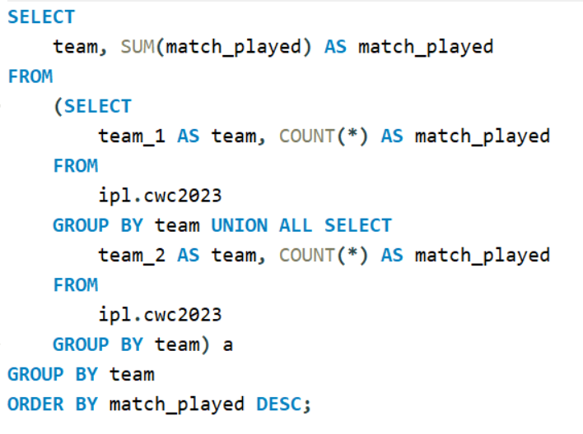
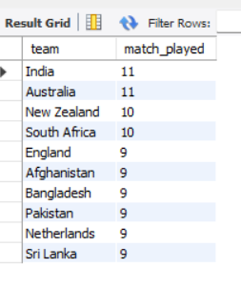
Number of matches played by each teams

Slide 14
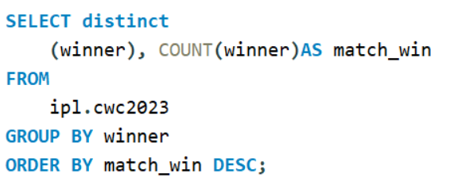
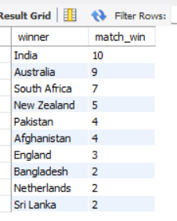
Total number of match win by each team

Slide 15
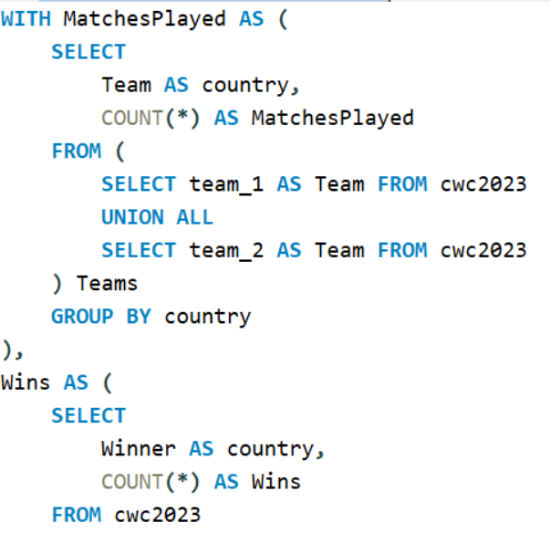
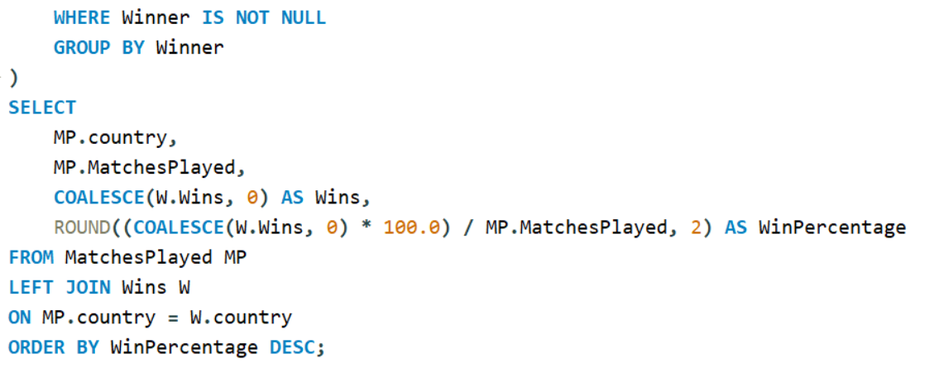
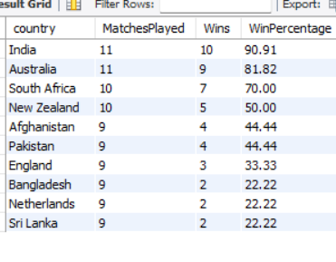
win percentage of each team

